Slide 1
AI Resume Detector
Eshaan Karanth | GenAI Intern
Date: 18/06/25

Slide 2
Problem Statement
Current challenges:
Plagiarized resumes
AI-generated resumes
Effects:
Inefficient hiring
Risk of poor hire

Slide 3
Objectives
Automate plagiarized resume screening, reducing manual efforts
Improve hire quality
Streamline operations for the HR/Recruitment team

Slide 4
Approaches for AI Detector
Research:
Investigated the prevalence of AI-generated resumes in hiring, focusing on patterns (e.g., overly polished text, generic phrasing) produced by tools like ChatGPT.
Reviewed transformer-based models (e.g., BERT, DeBERTa) for text classification, prioritizing accuracy and efficiency for resume-sized inputs.
Identified datasets (e.g., Kaggle resume datasets) for training and fine-tuning to distinguish human vs. AI-generated text.
Tools Used:
Selected microsoft/deberta-v3-small for its balance of accuracy and computational efficiency.
Evaluated text extraction tools (PyMuPDF, unstructured) to preprocess resumes for model input.
Chose Streamlit for a user-friendly UI, displaying results as a percentage table for HR usability.

Slide 5
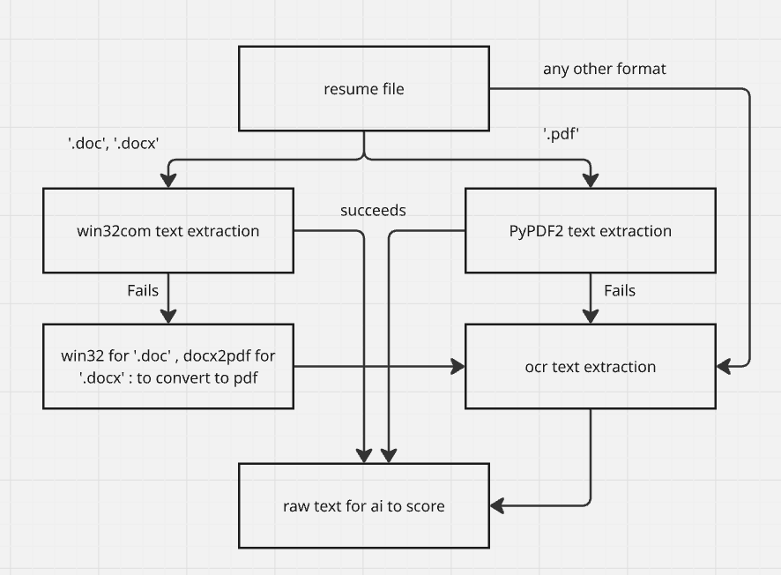
AI Detector Text Extraction Logic:

Slide 6
Approaches used for Plagiarism Module:
Metrics Used:
Cosine Similarity
TF-IDF Similarity
Fuzzy Similarity (Levenshtein Distance)
N-gram Similarity
Bleurt score

Slide 7
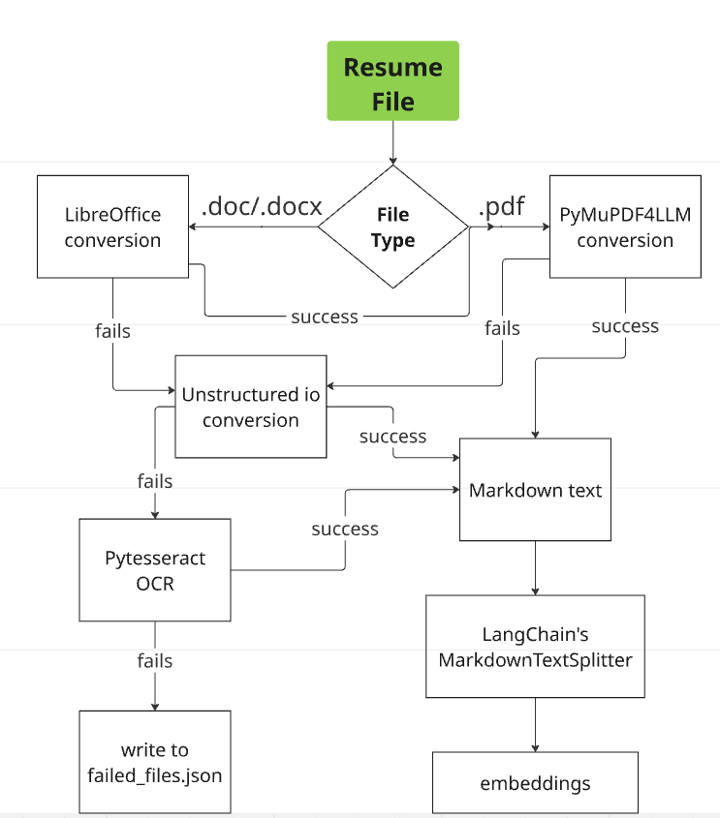
Text Extraction Logic for Plagiarism Detection Module:

Slide 8
Demo time!

Slide 9
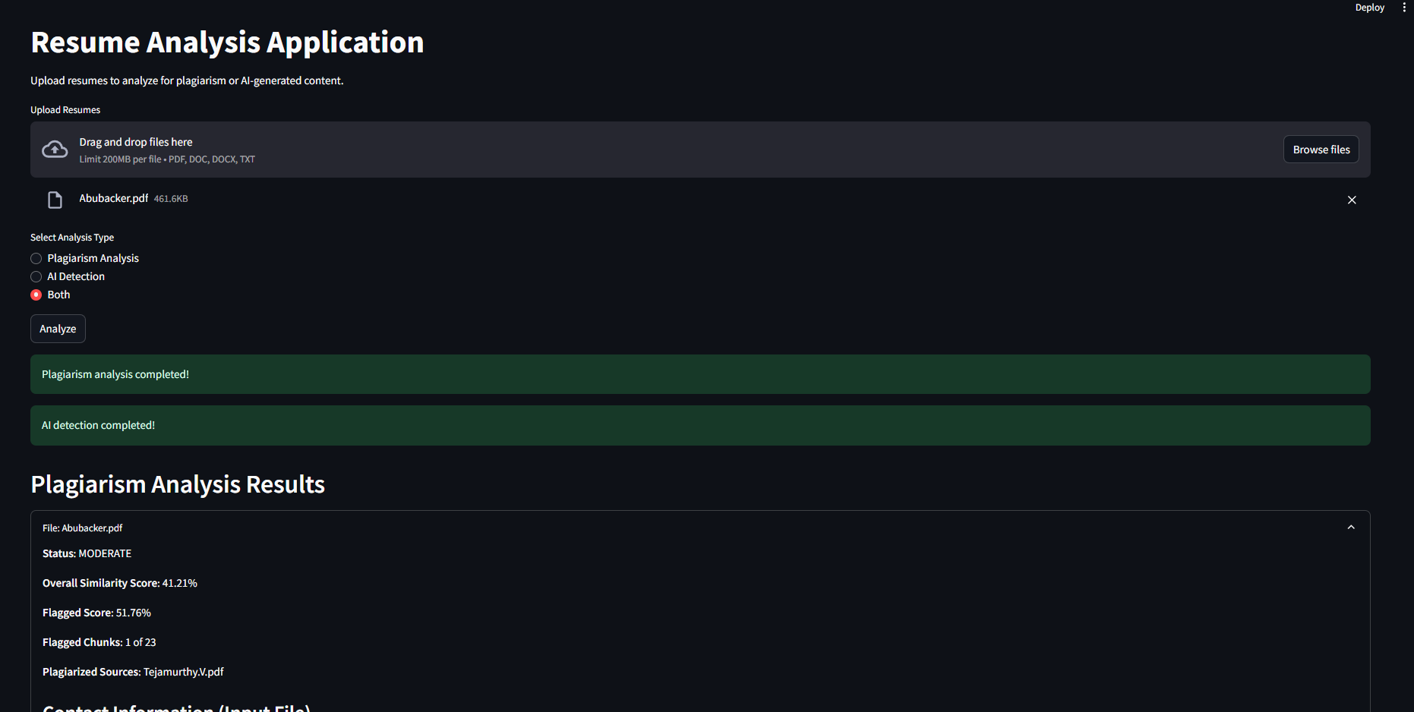
Sample Output

Slide 10
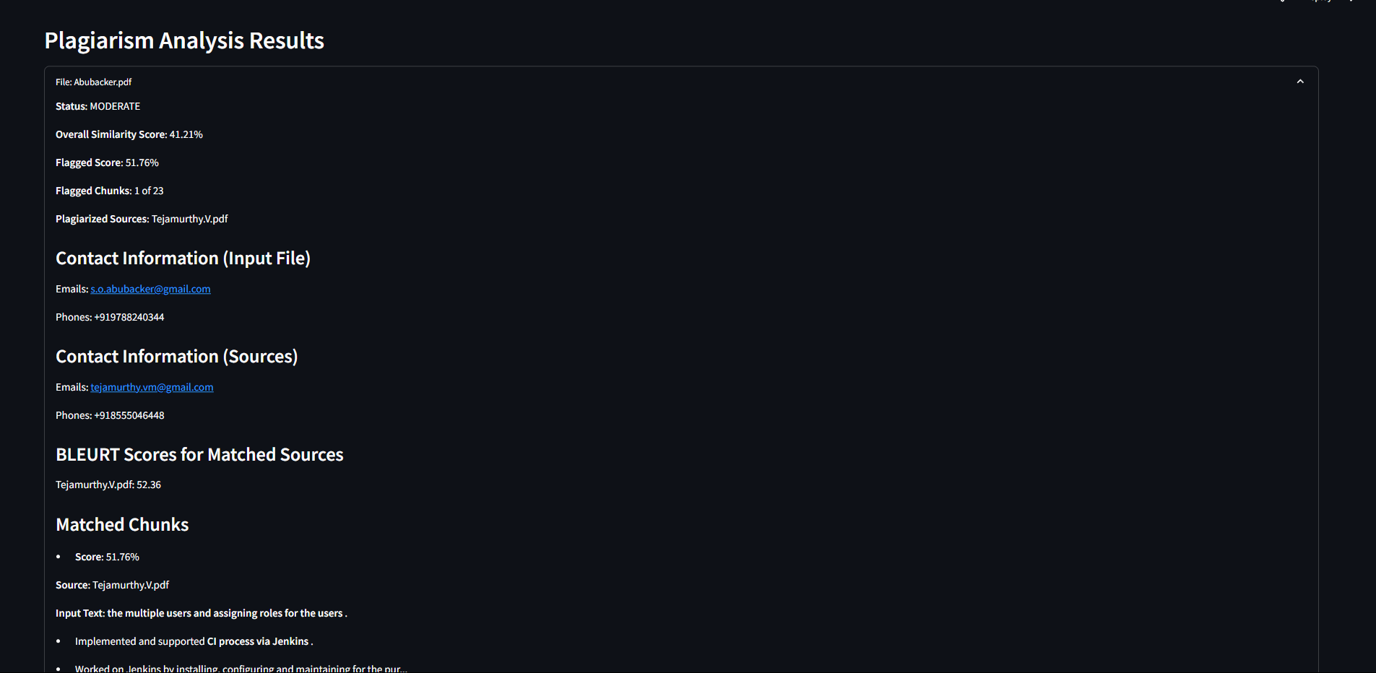

Slide 11
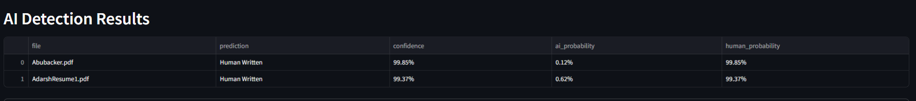

Slide 12
Insights and next steps:
HR/Recruitment team can benefit from these 2 modules to increase the efficiency and transparency in hiring process.
This project can be integrated to the PramitiHR product as a separate service to increase the quality of candidates being hired.

Slide 13
Thank you!

Slide 14
Appendix

Slide 15
Training of AI Detector:
The machine learning system classifies resumes as AI-generated or human-written using the DeBERTa-v3-small model. The training pipeline includes:
Data Loading: Processes CSV datasets from ./kaggle_data, balancing AI and human resumes (5600 resumes).
Preprocessing: Cleans text, tokenizes with a max length of 384, and splits data.
Training: Uses Hugging Face's Trainer with 5 epochs, early stopping, and F1-based model selection. Optimizations include bf16 (if supported), gradient accumulation, and checkpointing.
Evaluation: Computes accuracy, precision, recall, and F1 on a test set, saving the best model.
Efficiency: Manages memory with garbage collection and CUDA cache clearing.

Slide 16
The training configuration for the OptimizedKaggleAIResumeDetector is defined in the create_training_args method using Hugging Face's TrainingArguments. Below is a concise summary of all training parameters:
Output Directory: ./ai_resume_detector_optimized (saves model checkpoints and logs).
Epochs: 5.
Batch Size:
Training: 16 per device, with 3 gradient accumulation steps (effective batch size: 48).
Evaluation: 24 per device.
Learning Rate: 2e-5.
Scheduler: Cosine with 10% warmup ratio.
Optimizer: AdamW (adamw_torch).

Slide 17
Weight Decay: 0.01.
Gradient Clipping: Max norm of 1.0.
Mixed Precision:
bf16 if supported on CUDA-enabled GPU.
Falls back to fp32 otherwise.
Evaluation Strategy: Every 100 steps.
Save Strategy: Every 100 steps, with a limit of 3 checkpoints.
Model Selection: Loads best model at end based on F1 score (higher is better).
Early Stopping: Patience of 3 evaluation steps.
Efficiency:
Gradient checkpointing enabled.
Data loader: Pinned memory, 2 workers.
Logging: Every 50 steps, saved to {output_dir}/logs.
Reporting: Disabled (report_to="none").

Slide 18
Additional Settings:
dataloader_pin_memory=True for faster data transfer.
max_grad_norm=1.0 for stable gradients

